Slide 1
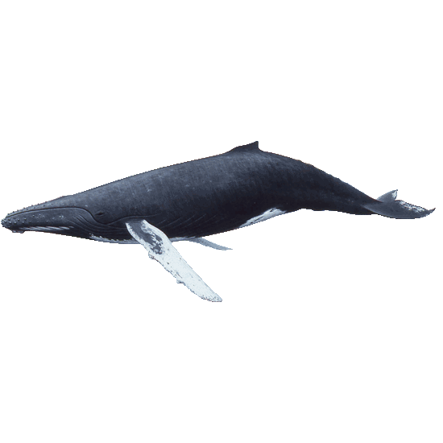
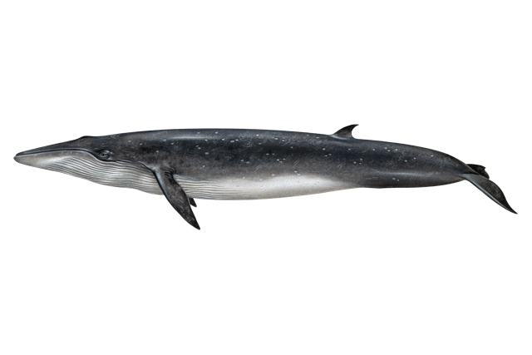


Data Visualization: Marine Mammals
M
Meghan Conway, Erik Osterlund, Ly Li, Katie Quinn
Notes:
Meghan

Slide 2
Project Proposal
M
Anthropogenic CO2 emissions absorbed into the world’s oceans
Increased ocean pH
Marine mammals fall outside their narrow window of acceptable pH
Source(s): Forecast Fish and Marine Mammal Population Responses to Ocean Acidification in the North Pacific Ocean and Bering Sea (NOAA)
Marine Mammals (WHOI)
Our Question: To what extent have sea mammal sightings changed as a result of rising sea temperatures?
Notes:
Meghan

Slide 3
Hypothesis / Questions
Hypothesis: If sea mammals are being affected by rising sea temperatures, then sightings will be geographically sparse and declining over time.
Questions:
In what geographic area(s) are sea mammals the most conspicuous?
What are the most sighted sea mammal species?
How has the frequency of (reported) whale sightings changed in the last decade?

Slide 4
Our Data : OBIS-SEAMAP
E
Notes:
Erik

Slide 5
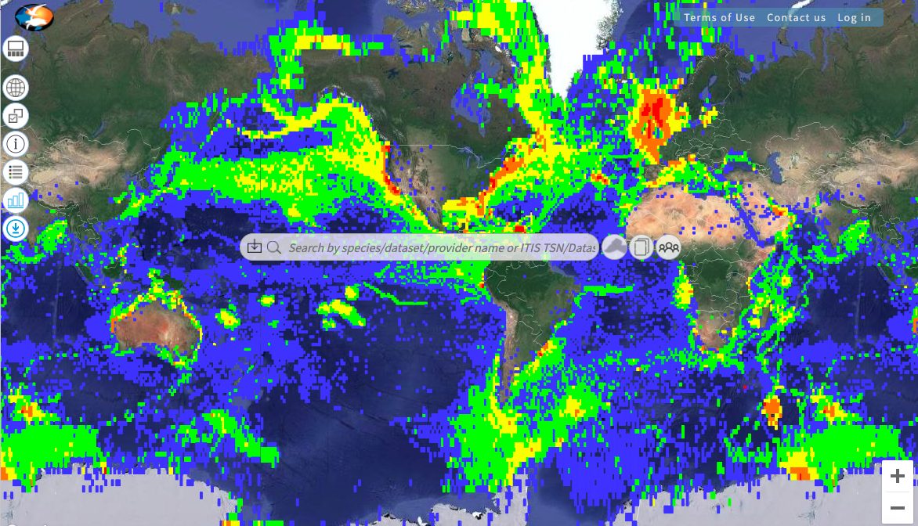
Ocean Biodiversity Information System Spatial Ecological Analysis of MegaVertebrate Populations (OBIS-SEAMAP)
E
Notes:
Erik

Slide 6
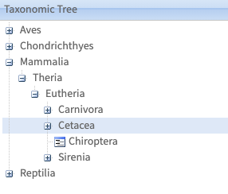
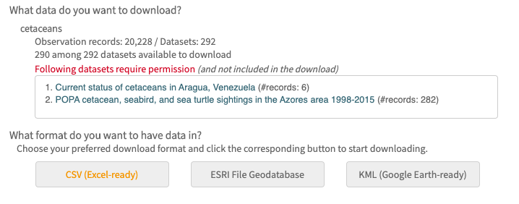
Choosing Our Data
E
Data from Duke.edu compiling logs of sightings
Taxonomic Tree Function in OBIS-SEAMAP
Exported as CSV
Notes:
Erik

Slide 7
Cleaning Our Data
E
We imported the data from a csv file into a dataframe & removed columns that did not reference relevant measurements. (Identifiers, Dataset labels, etc.)
For graph that quantified species on Question #2, we removed all entries of sightings that included more than 1 species for clarity.
For all analysis on the parameter, “number sighted,” entries with 0(NaN Value) animals were omitted because geotagging data report was not confirmed to have at least 1 animal
Notes:
Erik

Slide 8
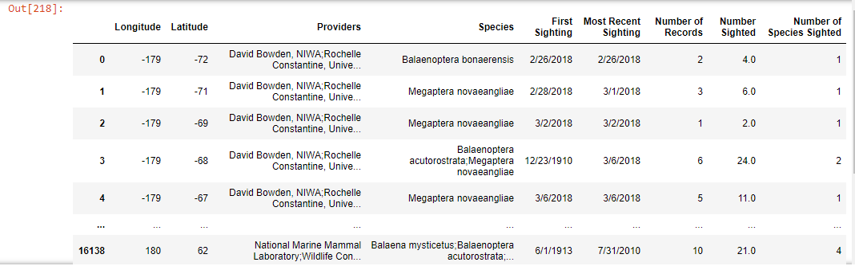

Slide 9
Summary of Amount of Species Sighted
E
 | Number Sighted
Count | 80072
Mean | 5.689792
Standard Deviation | 27.71236
Minimum | 0
25% | 1
50% | 2
75% | 4
100% | 1178
Notes:
Erik

Slide 10
Q1: In what geographic area(s) are sea mammals the most conspicuous?
M
Notes:
Meghan

Slide 11
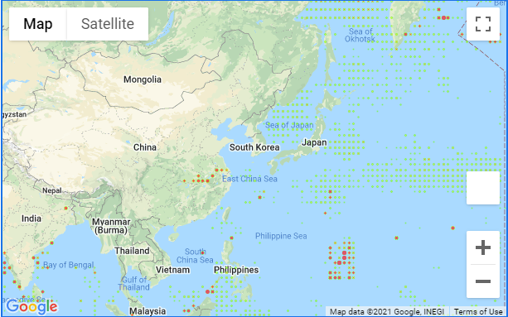
East Asia
Q1: At what climate are sea mammals the most conspicuous?
L
Notes:
Ly Li

Slide 12
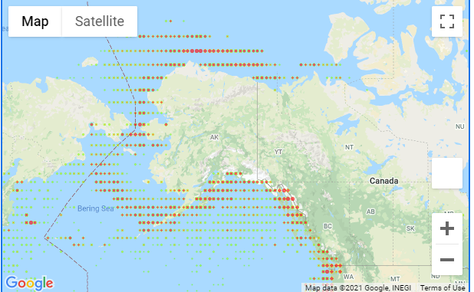
Alaska
Q1: At what climate are sea mammals the most conspicuous?
M
Notes:
Meghan

Slide 13
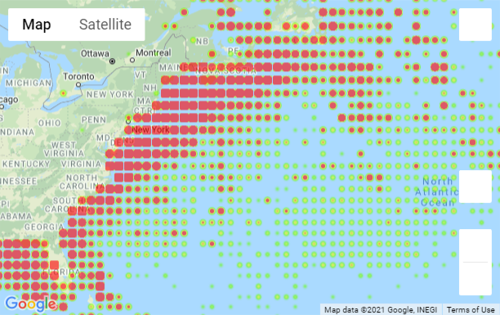
U.S. East Coast
Q1: At what climate are sea mammals the most conspicuous?
K
Notes:
Katie

Slide 14
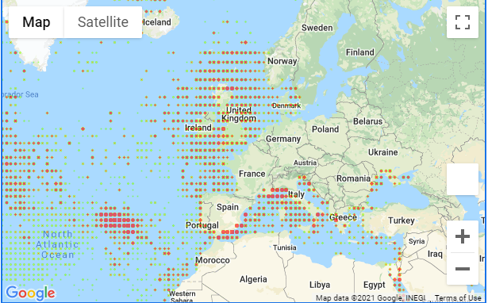
Europe
Q1: At what climate are sea mammals the most conspicuous?
E
Notes:
Eric

Slide 15
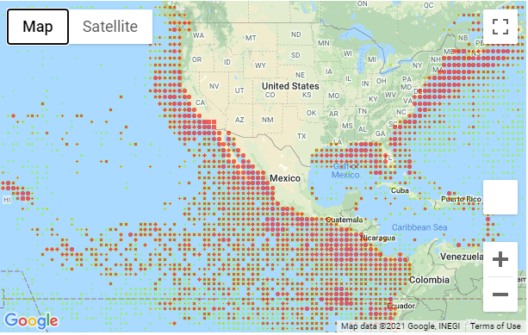
North America
Q1: At what climate are sea mammals the most conspicuous?
E
Notes:
Erik

Slide 16
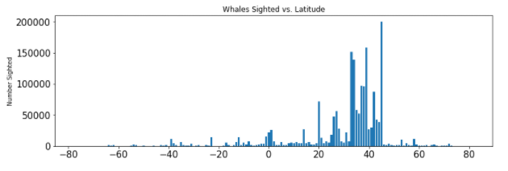
Latitude vs. Number of Sightings
Q1: At what climate are sea mammals the most conspicuous?
L
Notes:
Ly Li

Slide 17
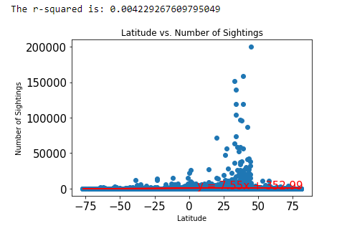
Latitude vs. Number of Sightings
Q1: At what climate are sea mammals the most conspicuous?
L
Notes:
Ly Li

Slide 18
Q2: What are the most sighted sea mammal species?
K
Notes:
Katie

Slide 19
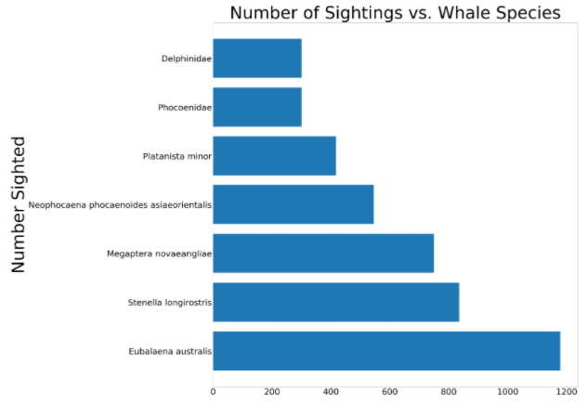
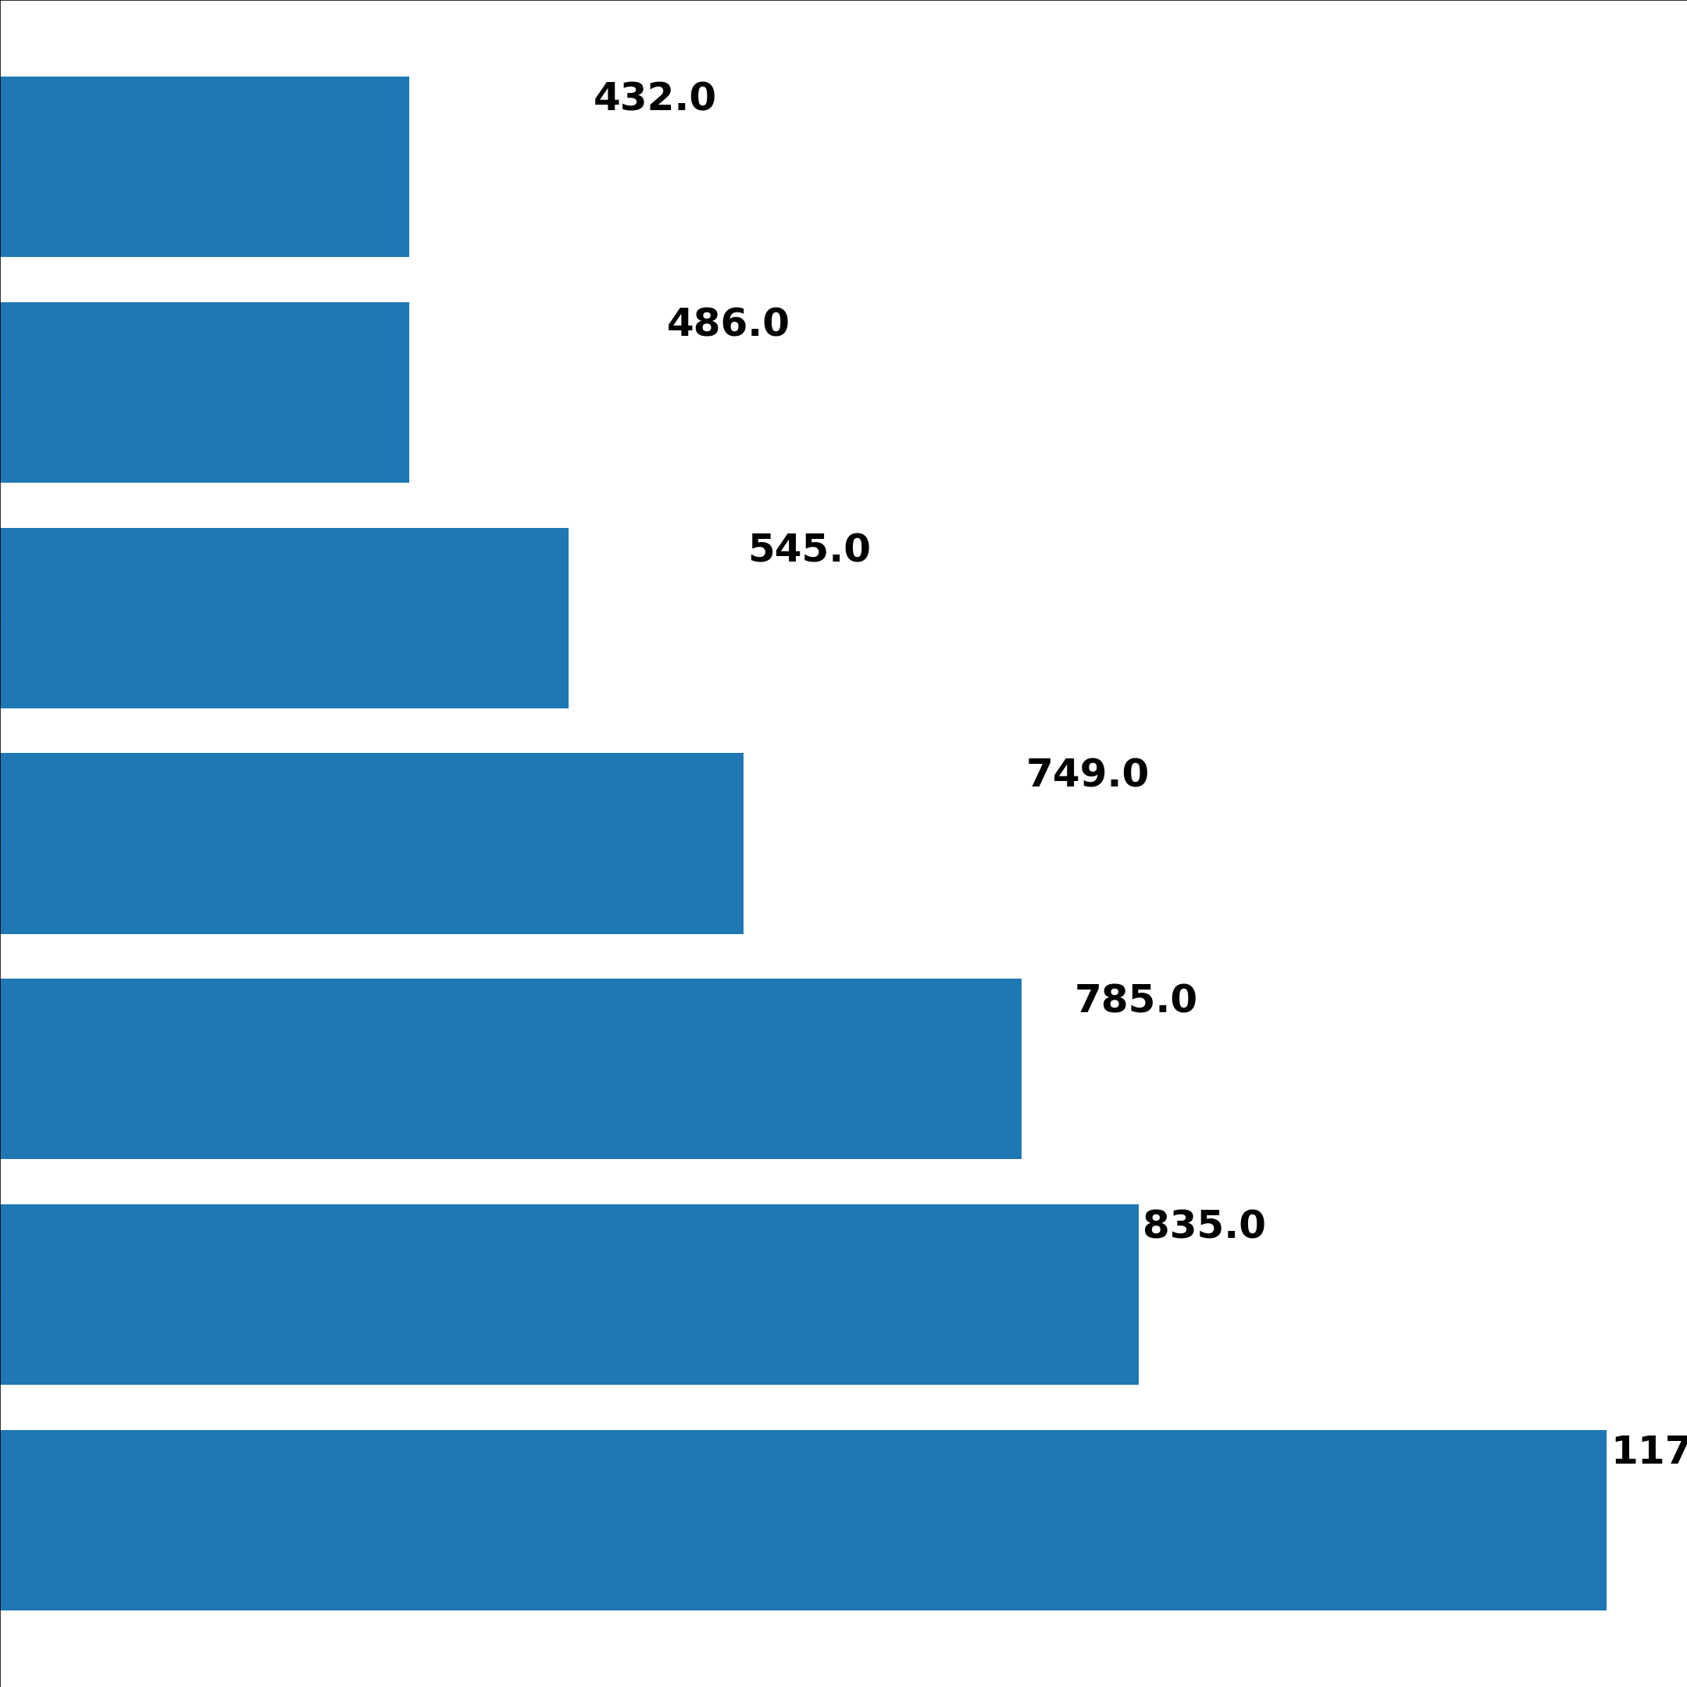
Q2: What are the most sighted sea mammal species?
K
7. Oceanic dolphins
6. Earless seals
5. South Asian river dolphins
4. Yangtze finless porpoise
3. Humpback whale
2. Spinner dolphin
Southern right whale
Notes:
Katie

Slide 20
Q3: How has the frequency of (reported) whale sightings changed in the last decade?
L
Notes:
Ly Li

Slide 21
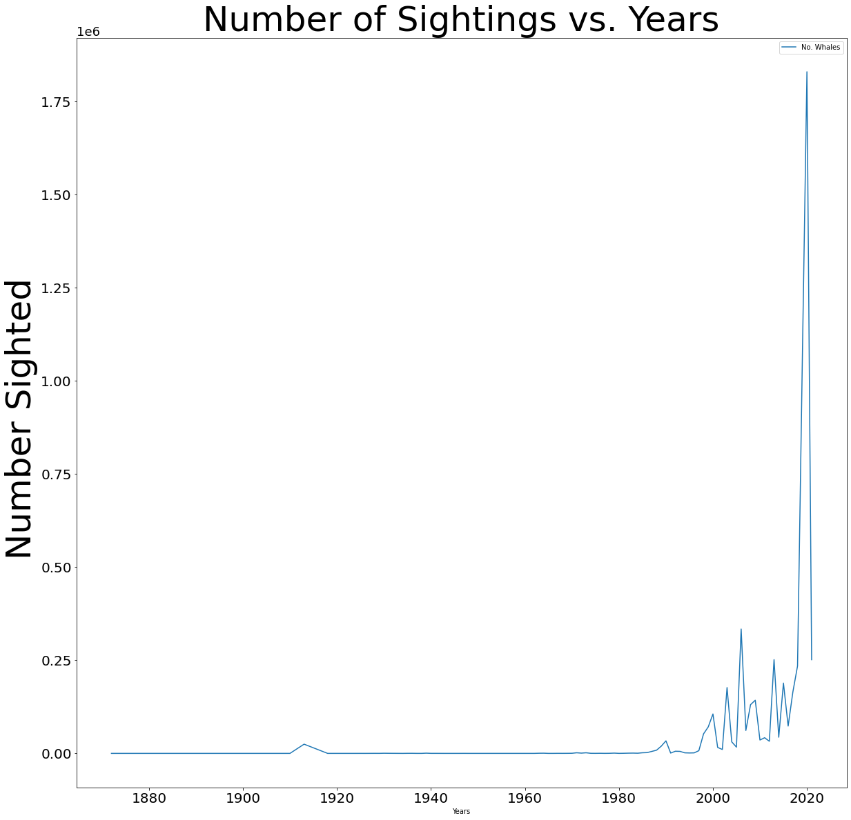
Q3: How was the frequency of (reported) whale sightings changed in the last decade?
L
Notes:
Ly Li

Slide 22
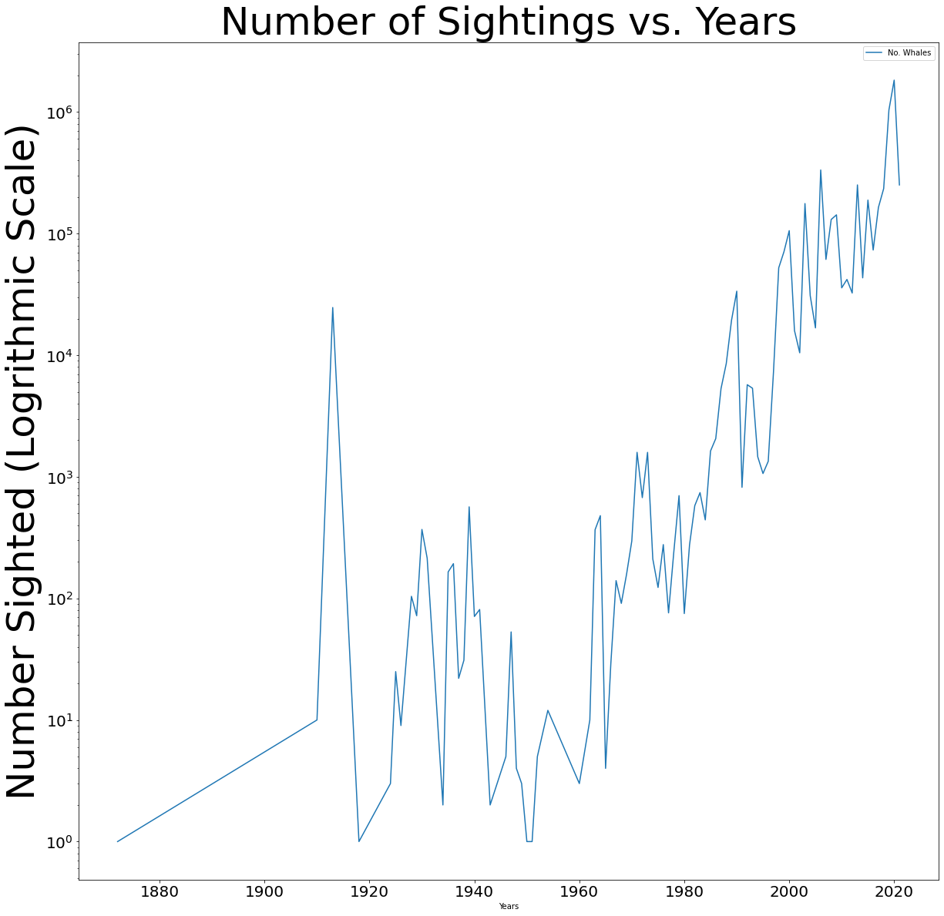
Q3: How was the frequency of (reported) whale sightings changed in the last decade?
L
Notes:
Ly Li

Slide 23
Conclusions
Sea mammals are the most conspicuous on the coasts of North America
Limitations: Are OBIS-SEAMAP users predominantly based in the U.S.?
The relationship between latitude and sea mammal sightings fails to be accepted (R-squared value)
The most sighted sea mammal species is the southern right whale
Limitations: Is this due to its size, conspicuousness, density of populations, or actual prevalence in the ocean?
Sea mammal sightings have dramatically increased since the early 2000’s
Limitations: Is this due to the increasing prevalence of technology? Apps that deliver the data to OBIS-SEAMAP?
With the limitations of this dataset, it is difficult to come to a conclusion about the impact of global warming on sea mammal populations (but increased efforts of tracking this data in the modern day may be fruitful in coming years!)
Notes:
Everyone

Slide 24
Thank you for your time! Questions?

